Slide 1
IBM University Engagement Project Submission
“Exploring the Power of Agentic AI with IBM Granite and IBM Bob”

Slide 2

Project Tile – Smart IoT Device Troubleshooting Chatbot
Domain of Project – Internet of Things(IoT).
Student Name | Recent Passport Photo | Email ID | Mobile number [WhatsApp]
AMRUTA ANANT GOUDA |  | amrutagouda20@gmail.com | 9481735585

Slide 3
Problem Statement -
Smart IoT Device Troubleshooting Chatbot
The Challenge:
IoT devices are widely used in homes, industries, and other connected environments. Users often face connectivity, configuration, firmware, and compatibility issues. Troubleshooting these problems can be difficult without technical knowledge .Finding solutions through manuals and customer support can be time-consuming.
The Objective
Develop an AI-powered chatbot to identify and resolve IoT device issues. Understand user problems through natural language.
Retrieve relevant information from IoT documentation using RAG.
Provide clear, step-by-step troubleshooting solutions
.Offer an interactive chatbot for quick and effective technical support.

Slide 4
Proposed Solution -
Proposed Solution– Proposed Solution: AI-Powered IoT Troubleshooting Assistant
The proposed solution is an AI-powered chatbot designed to identify and resolve IoT device issues related to connectivity, configuration, firmware, and compatibility using AI and natural language processing.
The system uses a Retrieval-Augmented Generation (RAG) pipeline to retrieve relevant information from IoT manuals, technical documentation, FAQs, and troubleshooting guides to provide accurate solutions.
The system consists of four key agents:
IoT Knowledge Agent: Retrieves relevant troubleshooting information using RAG.
Issue Detection Agent: Identifies device problems from user queries.
Troubleshooting Agent: Provides clear, step-by-step solutions.
Solution Verification Agent: Checks whether the issue is resolved and suggests alternatives if needed.
The solution includes an interactive chatbot that allows users to describe their problems in natural language and receive simple, personalized instructions.
Overall, the system provides a user-friendly IoT support assistant that reduces troubleshooting time and helps users resolve technical issues efficiently.

Slide 5
Technology Used
IBM Bob Platform – For designing and orchestrating AI agent workflows.
IBM Granite Model – For understanding user queries, reasoning, and generating troubleshooting solutions.
Python (FastAPI) – For developing the chatbot backend and handling user requests.
RAG (Retrieval-Augmented Generation) – To retrieve relevant information from IoT manuals and technical documentation before generating answers.
LangChain – For connecting AI models with document retrieval and chatbot workflows.
Vector Database (FAISS) – For storing and retrieving relevant IoT troubleshooting information.
Sentence Transformers – For converting IoT documentation into embeddings for semantic search.
Streamlit / HTML, CSS – For building a simple, interactive chatbot interface.

Slide 6
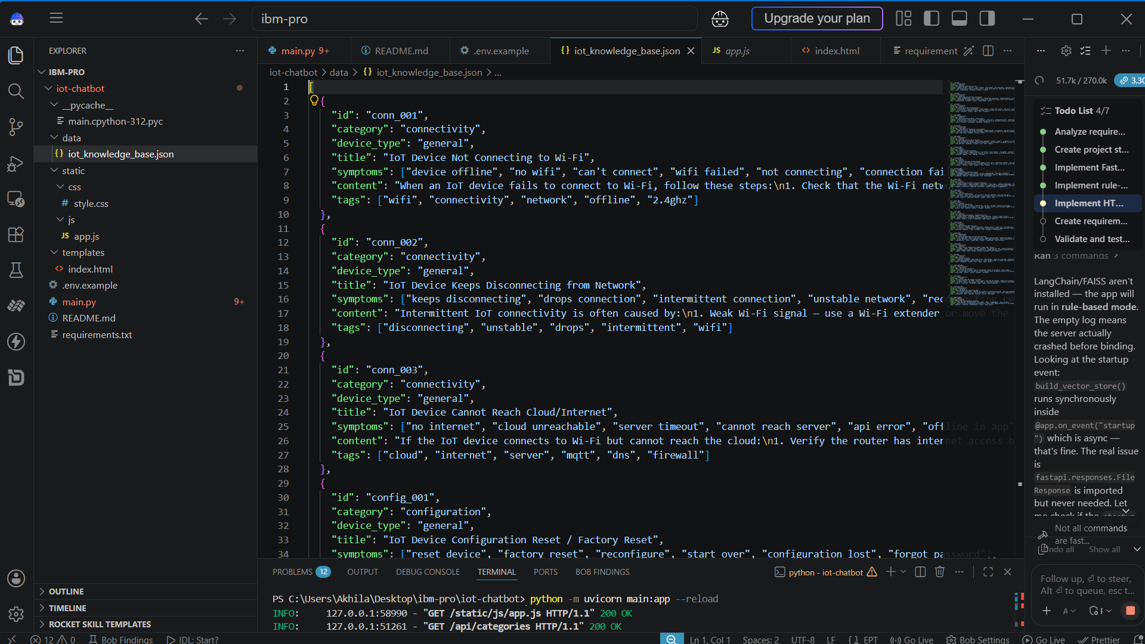
Required Files created using IBM bob -
App.py
Requirements.txt
Style.css
.env
Index.html

Slide 7
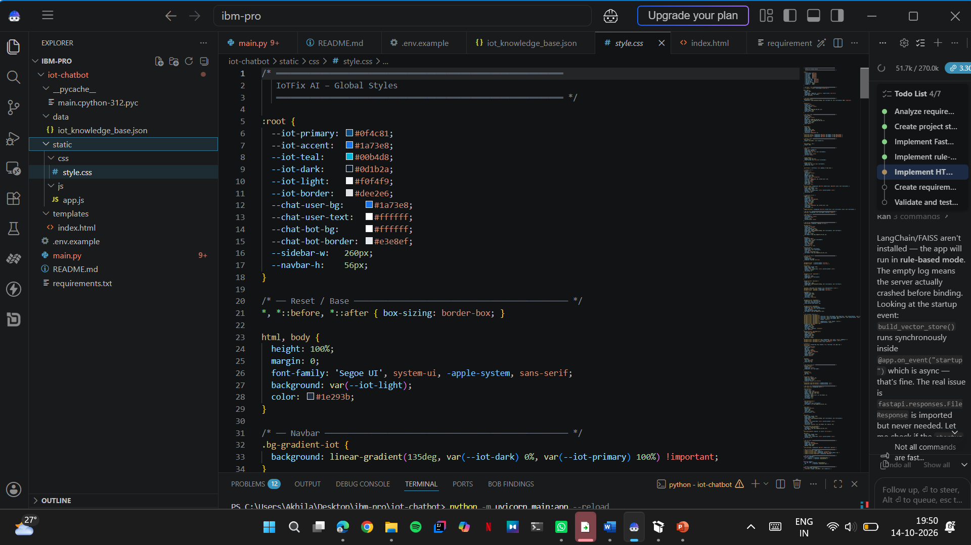
Style.CSS:

Slide 8
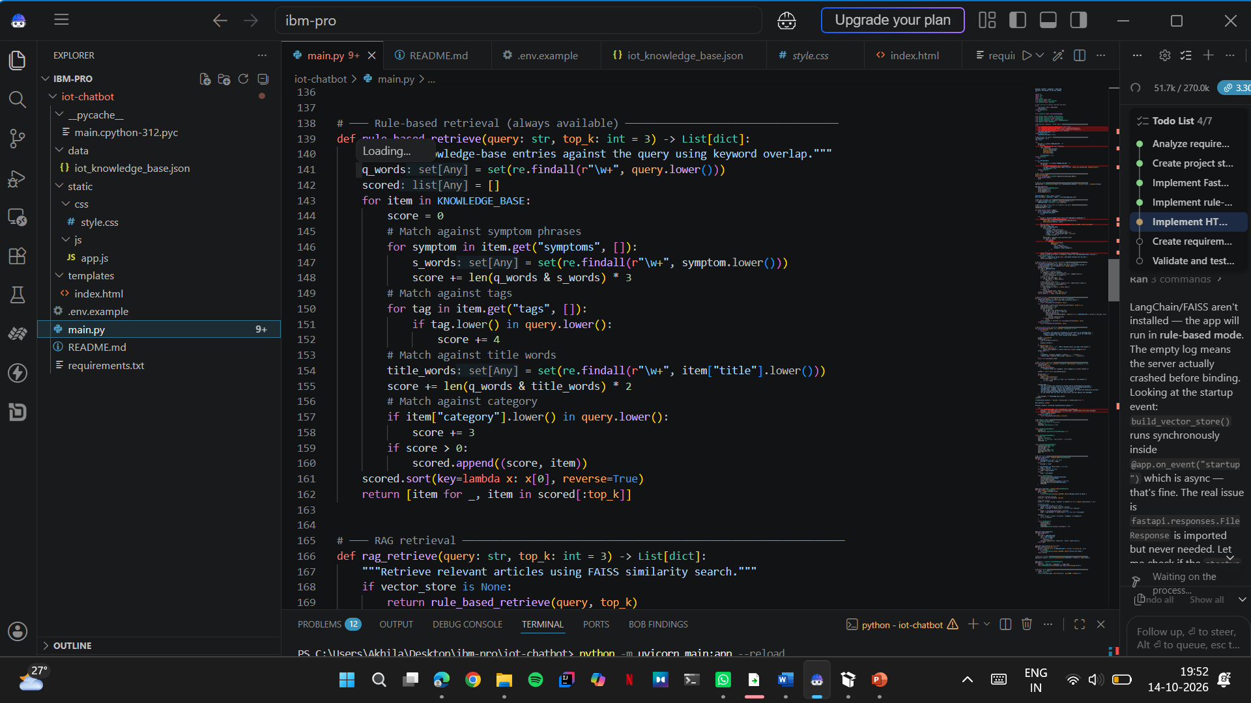

Slide 9
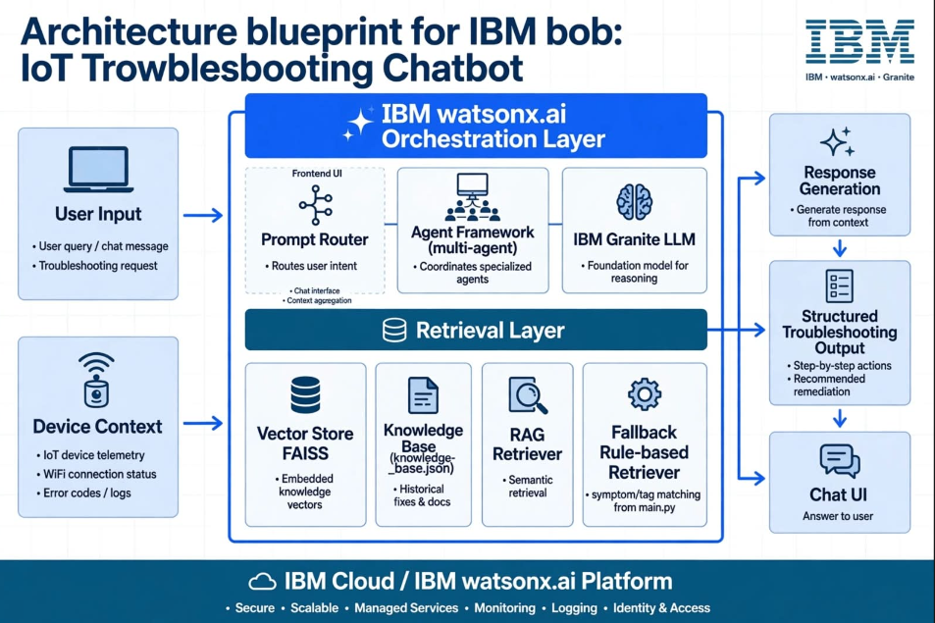
Architecture blueprint for IBM bob:

Slide 10
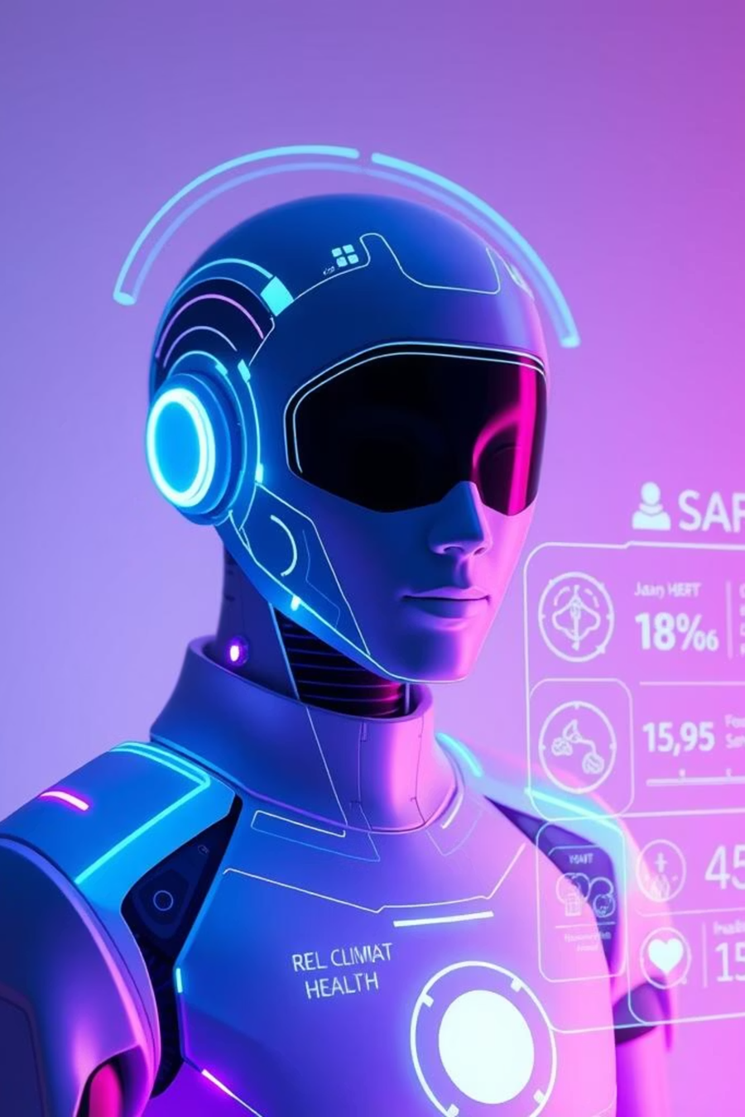
Role of Agentic AI in the solution
Role of Agentic AI in IoTroubleshooting
Autonomous Diagnosis: Identifies IoT device problems intelligently.
Multi-Agent System: Uses specialized agents for symptom analysis, knowledge retrieval, and solution generation
Context Awareness: Considers device models, error codes, and network status.
Adaptive Solutions: Updates troubleshooting steps based on user feedback.
Intelligent Support: Acts as a smart digital technician to resolve issues quickly.

Slide 11
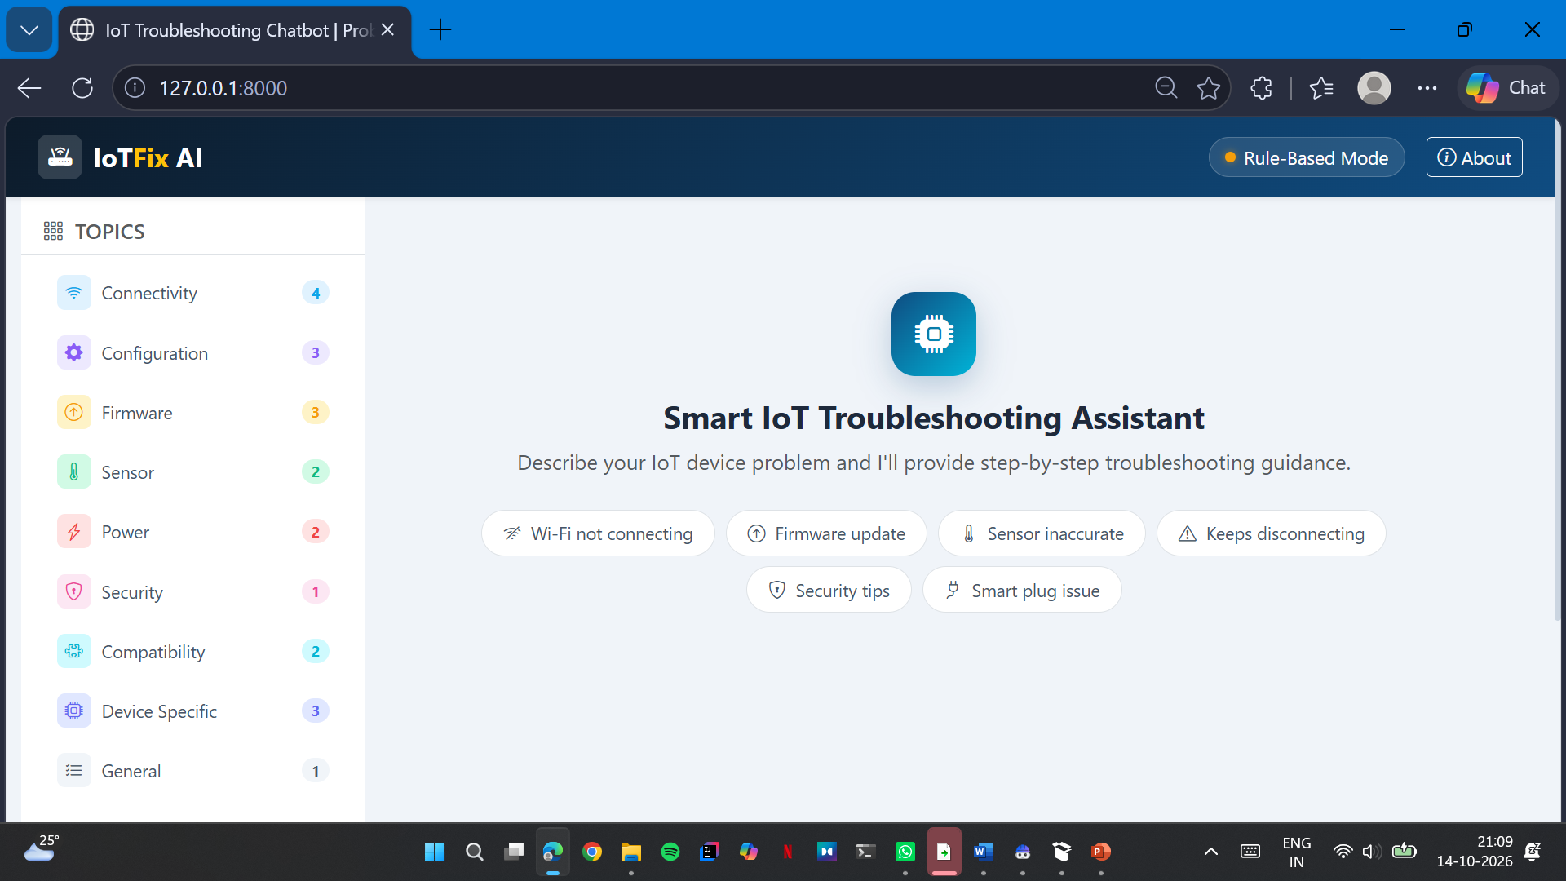
Project Output Screenshot
·
·
·

Slide 12
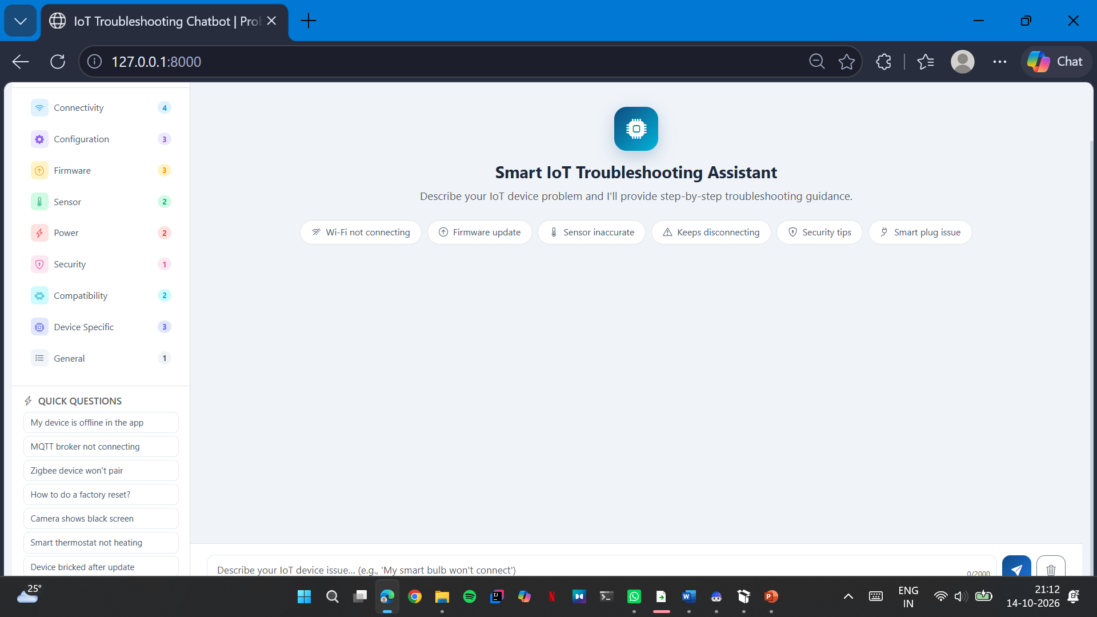
Project Output Screenshot
·
·
·

Slide 13
Project Output Screenshot
·
·
·

Slide 14
Novelty and Uniqueness
AI-Based Diagnosis: Understands IoT device problems described in natural language.
RAG-Based Knowledge Retrieval: Retrieves relevant information from IoT manuals and troubleshooting guides.
Personalized Solutions: Provides step-by-step troubleshooting instructions based on the user's specific issue.
Context-Aware Conversations: Uses previous messages to provide relevant follow-up guidance.
Intelligent Error Analysis: Identifies possible causes of connectivity, configuration, and firmware issues.
Beginner-Friendly Support: Explains technical solutions in simple language for non-technical users.
Faster Problem Resolution: Reduces the time spent searching manuals and contacting customer support.

Slide 15
Git Hub Link
· Please create public github repository (Enable Add README button while creating repository) with format –
Please test and Paste the working Github URL –
Make sure you have Uploaded following three files into your github repository
1) All Agent relevant files of IBM Cloud , 2) yourproblemstatement.pdf file 3) your projectpresntation.pptx file 4)any other files
·
·
·

Slide 16
Future Scope
Real-Time IoT Monitoring: Connect with IoT devices to monitor their status in real time.
Predictive Maintenance: Predict potential device failures before they occur.
Voice-Based Assistance: Enable users to troubleshoot problems using voice command
Multi-Device Support: Support different IoT devices and manufacturers.
Multilingual Support: Provide troubleshooting guidance in multiple languages.
Automated Issue Detection: Integrate sensors and device logs to detect problems automatically.
Mobile Application: Develop a mobile app for easy access to troubleshooting support.
·
·
·

Slide 17
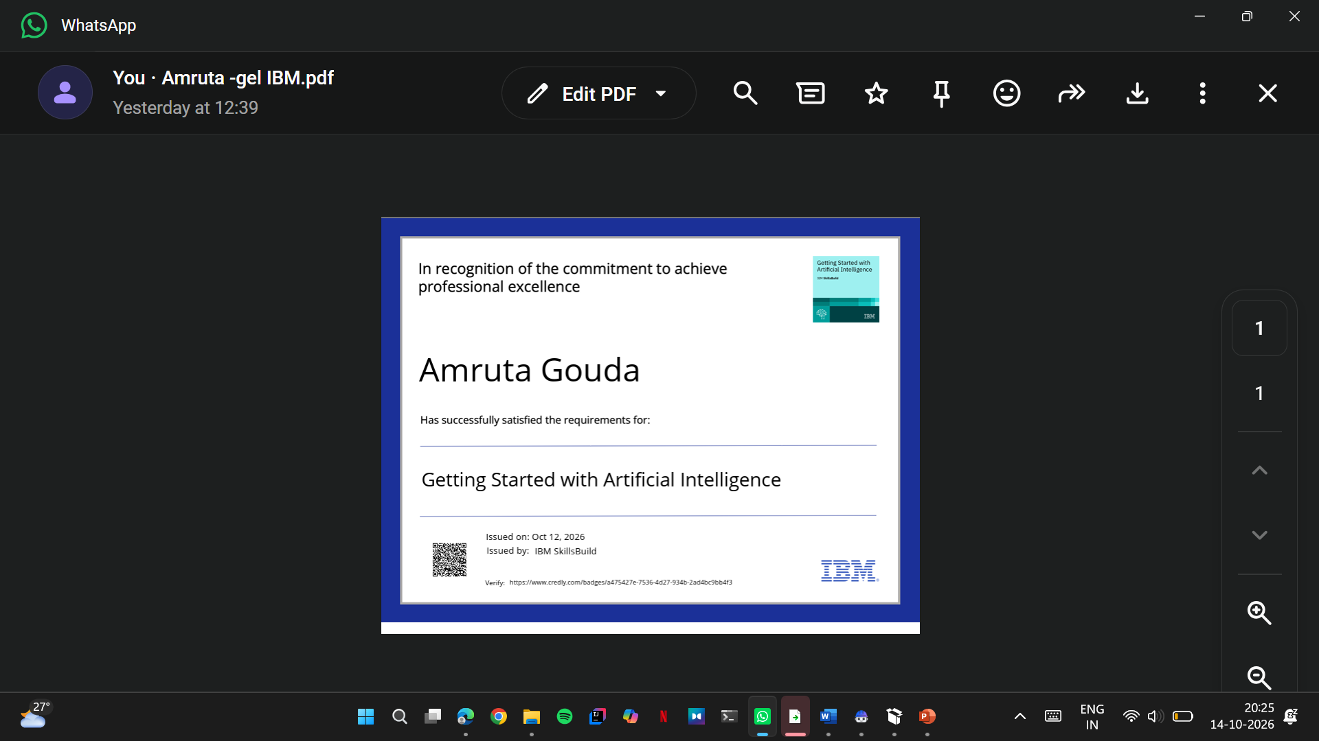
Certificates Earned:

Slide 18
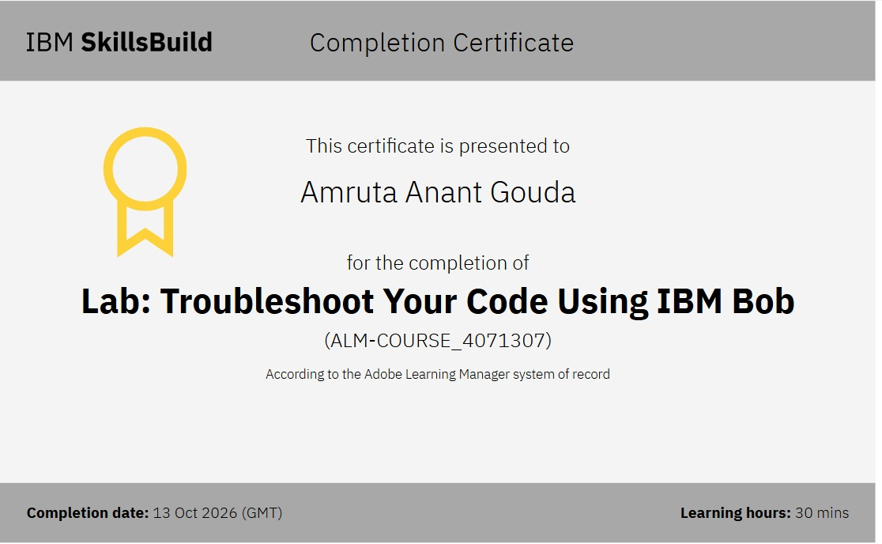
Certificates Earned:​

Slide 19


